Slide 1
Needs Assessment & Strategies
What’s Important?
ALIAS – Future of ALIAS – OCLC Integrated Fulfillment
Best Practices & Mentoring
Branding & Marketing
GIST
IDS Search
LAND
Membership; medical, public, outside NY, article only, growth & limits to scalability
Partners: vendors & library groups
Project Management
Statistics and Metrics
Sustainability; grants, infrastructure, succession planning, etc.
What are we missing?
Notes:
Feedback: Community support

Slide 2
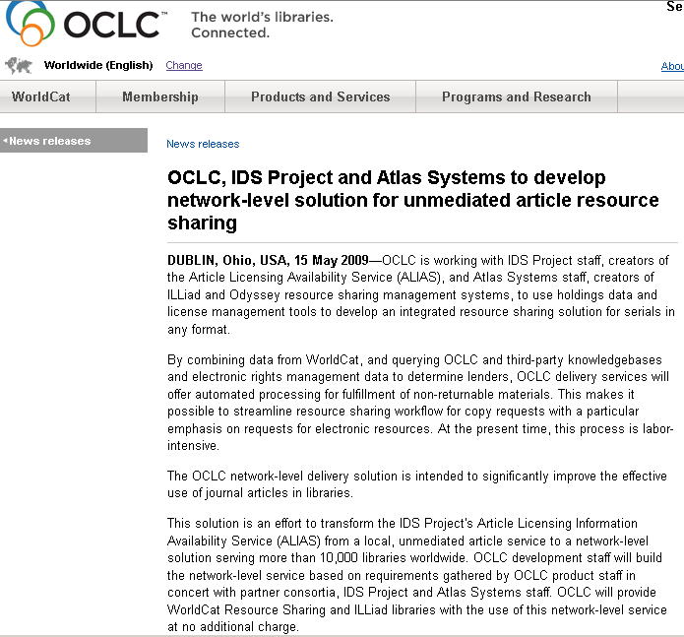
Needs Assessment & Strategies
What’s Important?
ALIAS – Future of ALIAS – OCLC Integrated Fulfillment
OCLC Network Service
Beta testing January 2010
Beta Test &
Migration
Notes:
Details of each; IF – OCLC is developing their network level service for all ILLiad, WRS, Navigator libraries at no additional charge.
http://www.oclc.org/news/releases/200929.htm

Slide 3
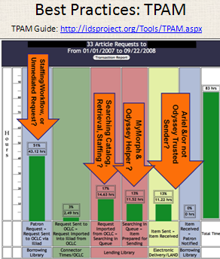
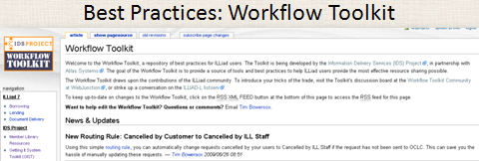
Needs Assessment & Strategies
What’s Important?
Best Practices & Mentoring
Notes:
How important are these strategies?

Slide 4
Needs Assessment & Strategies
What’s Important?
Branding & Marketing
From Project to…
?
Notes:
What are we? Are we a project with never ending scope, where do we want to be?

Slide 5
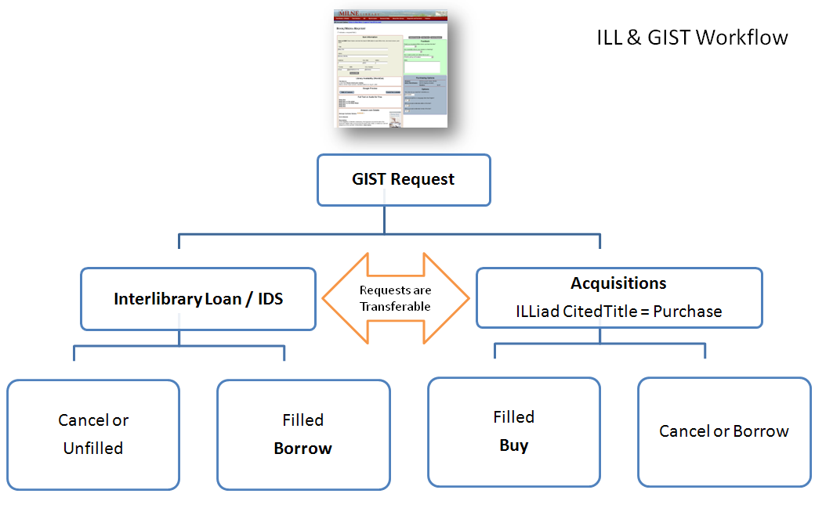
Needs Assessment & Strategies
What’s Important?
GIST?
Notes:
What relationships, functions and workflow make sense in the near future? How do we prepare our staff and users for those changes?

Slide 6
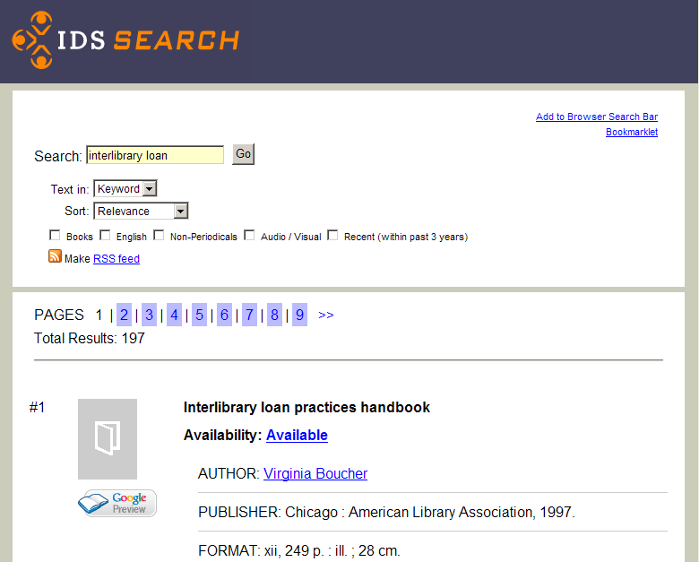
Needs Assessment & Strategies
What’s Important?
IDS Search
Notes:
How important is shaping the discovery resources around what is readily available?

Slide 7
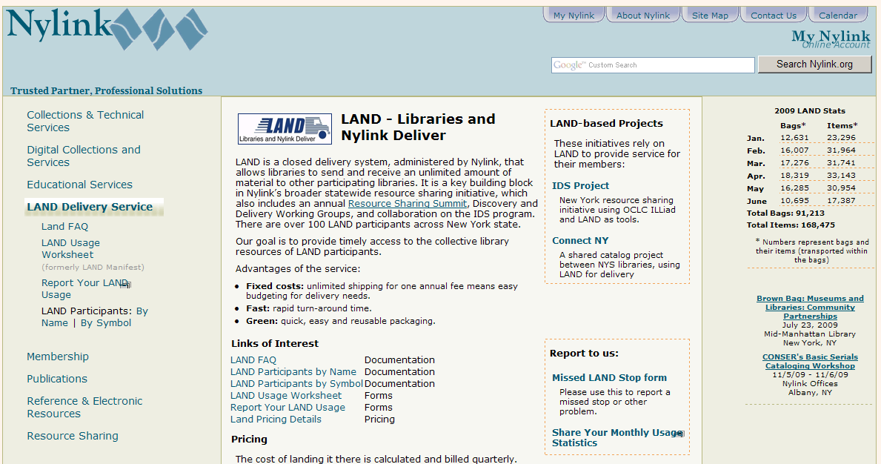
Needs Assessment & Strategies
What’s Important?
LAND
Notes:
The importance of LAND and Velocity to loan traffic…

Slide 8
Needs Assessment & Strategies
What’s Important?
Membership;
Medical libraries,
Museums
Public libraries,
Libraries outside NY,
Article only members,
What growth limits and scalability issues?

Slide 9
Needs Assessment & Strategies
What’s Important?
Partners: vendors & library groups

Slide 10
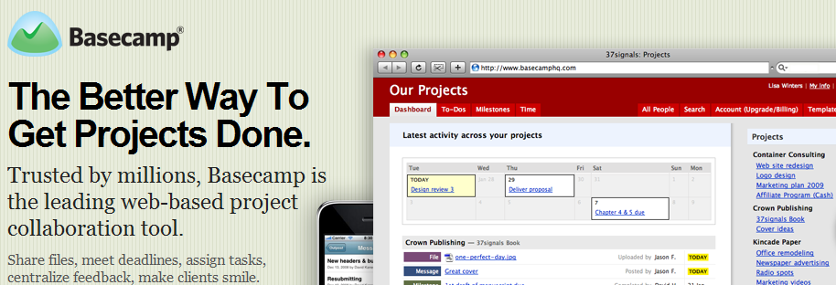
Needs Assessment & Strategies
What’s Important?
Project Management
Notes:
https://idsprojectny.basecamphq.com/
Feedback:
Nazareth uses Basecamp

Slide 11
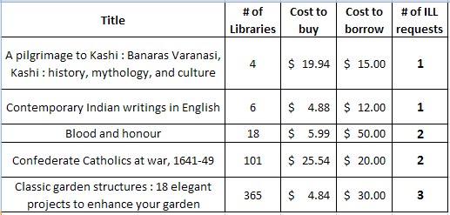
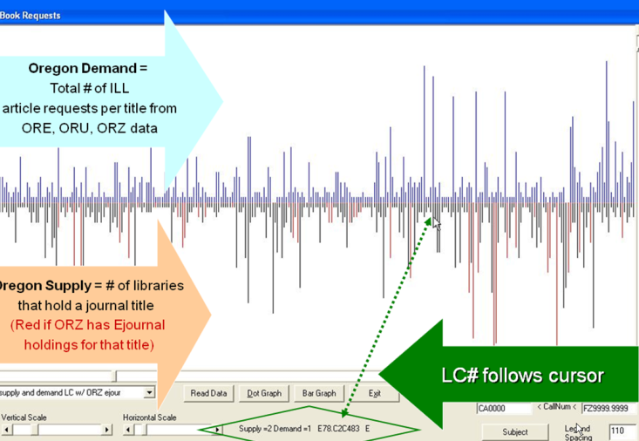
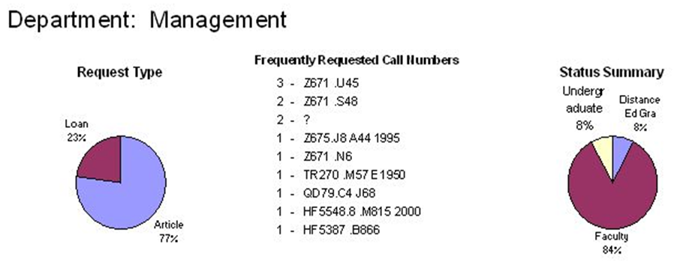
Needs Assessment & Strategies
What’s Important?
Statistics and Metrics
TPAM 2 – Metrics & Resource Profiles
Notes:
SUNY CCD is interested in looking at IDS Data
What do you want; user satisfaction, etc. What kind of reports would help individual members?
You get what you measure – are we measuring something that we can change?

Slide 12
Needs Assessment & Strategies
What’s Important?
Sustainability; grants, operational administration and planning, succession planning, infrastructure, etc.
What is essential to sustain this “community of trust and support”?
What similar models exist?
Any examples come to mind?
Group project time… at each table, please spend 10 minutes discussing these two questions and be prepared to give a 1 minute summary
Notes:
Feedback
Group 1: Admin-Support (apparent to staff), Clone Ed (mentor replacement), future leaders of IDS.
Group 2: Small scale, caution with vendors (fees), common tools unify, transparency (end users, systems staff, conference, vendors), affordability, mentoring model, shared commitment to user satisfaction.
Group 3: Communication between librarians, open channels, cost – future applications, training
Group 4: Scalability with outside libraries, outreach, mentoring, startup / steeper learning curve as we enhance products and services, change of leadership.
Group 5: Strategic growth controlled, centralize and distribute labor smartly, connect staff to IDS Project, support, Conferences – IDS and others
Group 6: Strengths: Community buys into goals, fee structured environment – decline of uniqueness & owe, nimbleness is key, grew out of libraries (practical strengths), need leadership is key to community, financial support, mentoring is modest, TPAM – Atlas, IDS Search – OCLC infrastructure
Group 7: Few committees, project based, systemic scale focus, mentoring, tradition/change, commitment to collaboration, education essential to change, mentoring grow/change, more proactive.
Group 8: 2 way communication, controlled growth (criteria for joining), transparency (enhance ideas…), Similar model: Habitat for Humanity.

Slide 13
Needs Assessment & Strategies
What’s Important?
ALIAS – Future of ALIAS – OCLC Integrated Fulfillment
Best Practices & Mentoring
Branding & Marketing
GIST?
IDS Search
LAND
Membership; medical, museum, public, outside NY, article only, growth/limit to scalability
Partners: vendors & library groups
Project Management
Statistics and Metrics
Sustainability; grants, infrastructure, succession planning, etc.
What are we missing?
Vote with a sticker…
You get 4 stickers
& 5 minutes
then break time…

